Slide 1
Sensor Descriptive Movements for localization
Michael Craze, Zheng Lu, Zhiyang Zhang
Notes:
9/30/13 04:00:54 PM
1

Slide 2
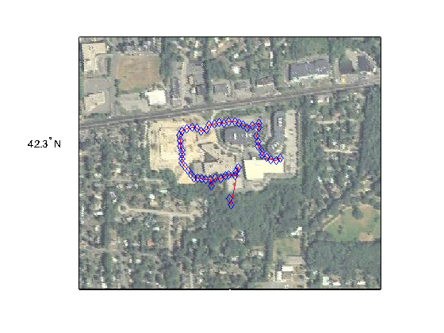
Notes:
Currently smartphone apps using GPS as their major source to acquire users’ location. Due to the limitation of GPS and advantage of sensors, we propose to use sensors on modern smartphones to assist to keep track the movements of users to get better performance in localization applications.

Slide 3
Introduction
Possible Applications
Measurements
System Overview

Slide 4
Disadvantage of GPS
More Power Consumption
Unpromising Startup Performance
Notes:
GPS will drain the battery in one or two hours and can hardly get responsive localization result. Since most embedded systems have very limited energy, this disadvantage makes it less practically in current embedded systems.
The second is that usually the startup performance is not very promising, which means once you lose GPS signal, you will need a quiet long time to get your location again. This disadvantage makes it less possible to use GPS in some tightly time-constrained applications.

Slide 5
Advantage of sensors
Negligible Power Consumption
Accuracy
Notes:
With or without used, sensors in smartphones are open all the time. The power consumption are negligible comparing to GPS.
Currently, most smartphones are equipped with sensors such as accelerometers, magnetometers and gyroscopes, which are capable of describing movement. By periodically monitoring these sensors and coordinately interpreting their readings, we can describe our movements with a acceptable accuracy.

Slide 6
Introduction
Possible Applications
Measurements
System Overview
Notes:
We have proposed 2 specific sample applications here.

Slide 7

Personal aerial videotaping
Notes:
We emphasis on low latency to meet the restrict timeconstraints of applications. These applications can hardly be implemented by only using GPS.

Slide 8
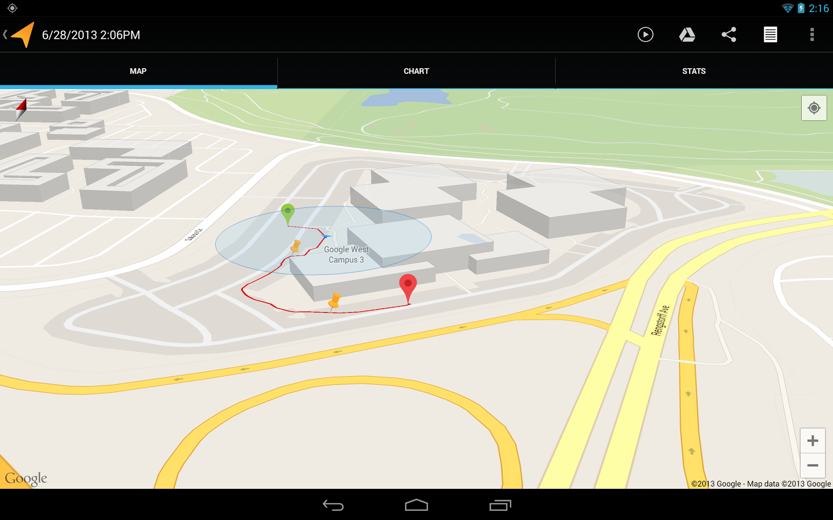
Path recording
Notes:
We emphasis on energy efficiency compared to regular GPS based path recording applications such as Google’s ”My Tracks”. The key idea in this application is that we will trying to use sensor readings to
decide the best time of turning on GPS, while the GPS is off during most of the time. Our goal is to reduce the turning on time of GPS as much as possible, so that more energy is saved. We will focus on this application in our following work.

Slide 9
Introduction
Possible Applications
Measurements
System Overview

Slide 10
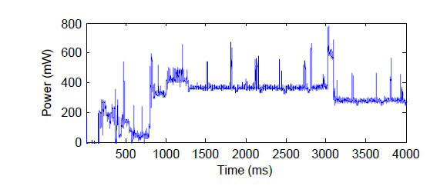
Energy consumption of GPS
  Detailed GPS power
Notes:
Before we trying to reduce energy consumption by replacing GPS with sensors as long as possible, we need to study the potential benefit of this method.
This figure gives a detailed measurement of energy consumption of GPS on Android smart phones. The power draw of GPS on android system has been measured at around 230mW compared to 324mW on Nokia N95.

Slide 11
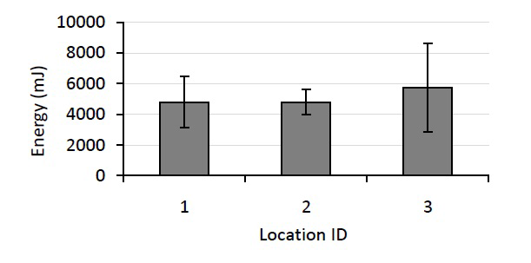
Energy consumption of GPS
  GPS cold start energy consumption of different locations
Notes:
Also, the energy consumption of GPS system varies when measure from different locations.
We can draw from Fig.3 that by using A-GPS, the cold start up time is around 25 seconds. Note that the energy consumption will drop to one forth when using a warm starts, that is, system has previous almanac or ephemeris data. Also, the warm start up time will be only around 6 seconds.

Slide 12
Energy consumption of sensors
Normal mode: I = 250uA
Low-power mode: I = 10uA
Power ≤ 1mW
Notes:
On the contrary, the sensors in smart phone requires far less energy.
Using iPhone 5s’s accelerometer chip STMicroelectronics LIS331DLH as an example. Under 2.5v supply voltage, the current consumption under normal mode is only 250uA and under low-power mode, this value is decreasing surprisingly to only 10uA. This means that the power consumption of this accelerometer is less than 1mW, negligible compared to power consumption of GPS.

Slide 13
Energy consumption of our approach
Using GPS discretely
Warm start up after initialization
Minimal interval to turn on GPS ≥ 6 seconds
Dominated by turn-on time of GPS
Notes:
In our implementation, we are considering using GPS signal discontinuously and using sensor readings to aid the locating when GPS is off.
It is economic if we can always using warm start up after the first start.
The minimal interval for us to turn on GPS should be larger than the warm start up time, that is, 6 seconds on average. GPS do not consume much more energy at start up than stable state. So, we can turn it off arbitrarily without facing any punishment in terms of energy consumption, but we may face a latency averaged at 6s when we trying to get location from GPS.
To conclude, the energy consumption of our method for locating is dominated by the power on time of GPS.

Slide 14
Characteristic of sensor readings
Accelerometer
Magnetometer
Notes:
In this section, we design a simple test to study whether the characteristic of sensor readings are suitable for our tracking purpose. During the test, we wrote a script running on an android smartphone to periodically recording accelerometer and magnetometer readings. We put the smartphone into the left pocket of pants and walking along a sidewalk. We take two turns during the walking.

Slide 15
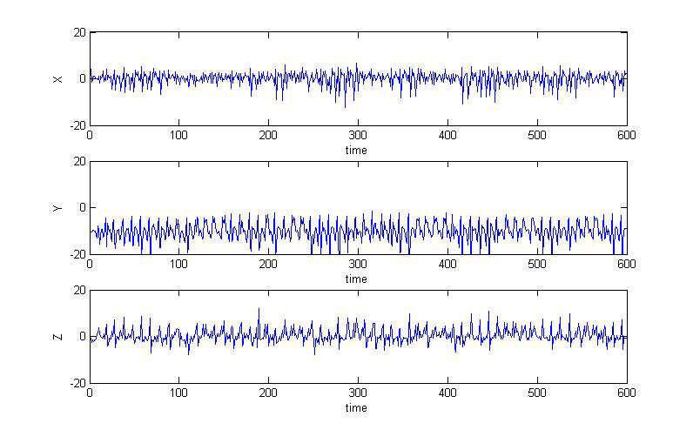
Accelerometer readings of xyz coordinate system during the test
Notes:
orientation of smartphone:
we can estimate the orientation of the cell phone, since the y axis is always around minus 10, which means that is the gravity.
orientation of moving:
since in most of the time, the sensor readings of y axis and z axis is near symmetric of its mean value, we can learn that the person carrying the smartphone is moving along the x axis.
direction of moving:
since the value is larger towards the minus direction of x axis, which means that we are approximately moving towards the minus x axis direction.

Slide 16
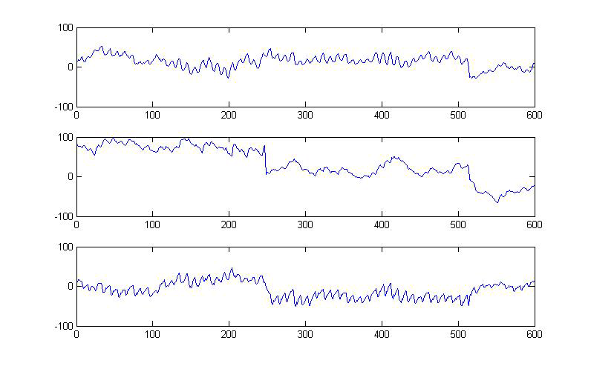
Magnetometer readings of xyz coordinate system during the test
Notes:
orientation of smartphone:
we can estimate the orientation of the smartphone,
this can help us using accelerometer and magnetometer
cooperatively to more precisely determine the orientation
of smartphone.
orientation of turnings:
more interesting result from the magnetometer readings
is that we can tell the direction of our turnings with these
readings. We are turning two times in this test scenario,
you can find obvious clue of this two turning especially from y axis.
From above results and analysis, we can conclude from this
experiment that we can draw sufficient information from sensor
readings to describe our movements and assist localization
when GPS is off.
Although, we can also see that, since the sensor readings are
suffering from volatiles because of the nature of our moving
pattern, we can not calculate accurate movements and locations
though these sensor readings. So the GPS is still necessary for
precise path recording of our approach.

Slide 17
Auxiliary method to improve accuracy
Geocoding: function of Google Map (Android)
Get the information of the road by coordinations
Notes:
Google map on android system provides a function called geocoding, which we can use the coordinations we have to get the information of the road. So when we use the path recording application in city scenario, we can define our location result on the road. This method can reduce the effect of volatile of sensor readings to the accuracy of the localization without incurring large energy consumption
compared to acquiring location from GPS.

Slide 18
Introduction
Possible Applications
Measurements
System Overview
Notes:
Our goal is to deliver a low energy consumption, real-time accurate path recording system. We will split our system into four parts according to their functionality, namely central controller, sensor data interpreter, map integrator, GPS coordinator.

Slide 19
Non-functional requirements
low power
real-time
accuracy
Notes:
low power:
The major concern of our system is its power consumption. That is the main reason we sacrifice simplicity of only using GPS.
real-time:
Since sensors do not suffering from high energy localization refresh overhead and long latency due to poor connection. So we are expecting that our approach our performs those only using GPS in terms of real-time in some scenarios such as urban areas, forests.
accuracy:
The most significant drawback of sensor approach is its poor accuracy. Although we can always increase the frequency of using GPS to achieve a better accuracy, this will reduce the benefit of our approach. We hope we can overcome low accuracy issue through better sensor readings interpreting algorithm design.

Slide 20
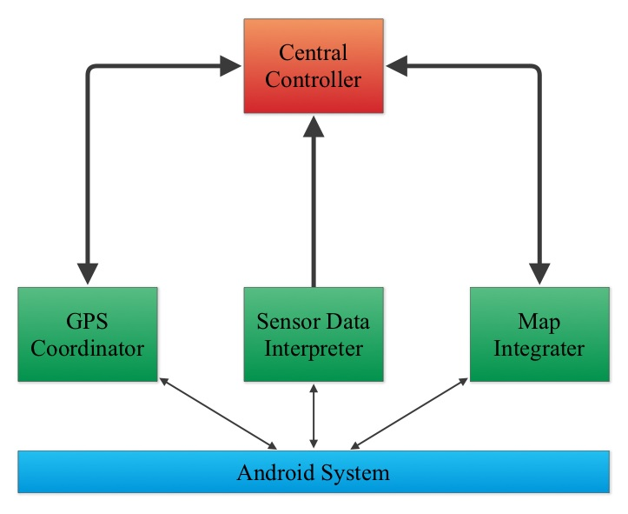
System components
Notes:
1) Central controller: The central controller is where we keep the main logic of our system. Other components are all connected to this component. The central controller will monitor the possible localization errors in our algorithm by combining movement descriptions from sensor data interpreter component and map auxiliary information from map integrators. It will also determine the frequency of using GPS.
This component will also provide the user interface.
2) Sensor data interpreter: This is the major part of our system. It contains the algorithm of interpreting the sensor readings into movement descriptions. It will provide this information to central controller.
3) Map integrator: This component has two functions. The first is to recording coordinate provided by central controller on the map. The second is to provide map auxiliary information to central controller to help determine the coordinate.
4) GPS coordinator: This component coordinates with GPS to manage the usage of GPS. It will provide coordinate acquired from GPS to central controller upon request.

Slide 21
Thank you!

